Slide 1
Cambrian School & College, Campus-5, Baridhara, Dhaka.
Welcome to my class my dear students.

Slide 2
Presentation Placement
Md Hasan Hafizur Rahman
Senior Lecturer
Department of English
Cambrian School & College
Campus -05, Dhaka
Junior School Certificate Examination (JSC)
English First paper
Paragraph
Writing Part

Slide 3
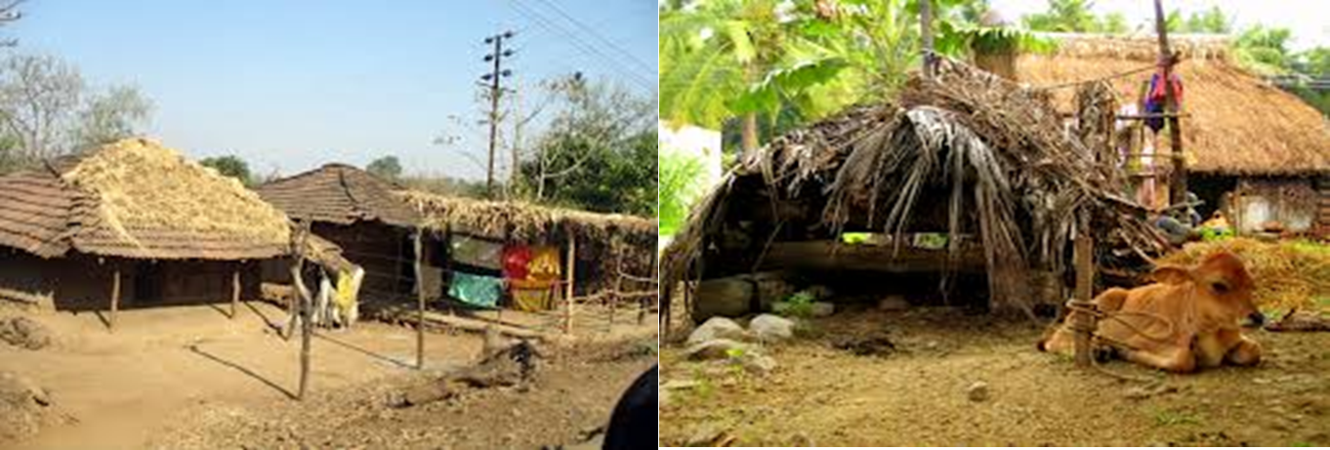
Village

Slide 4
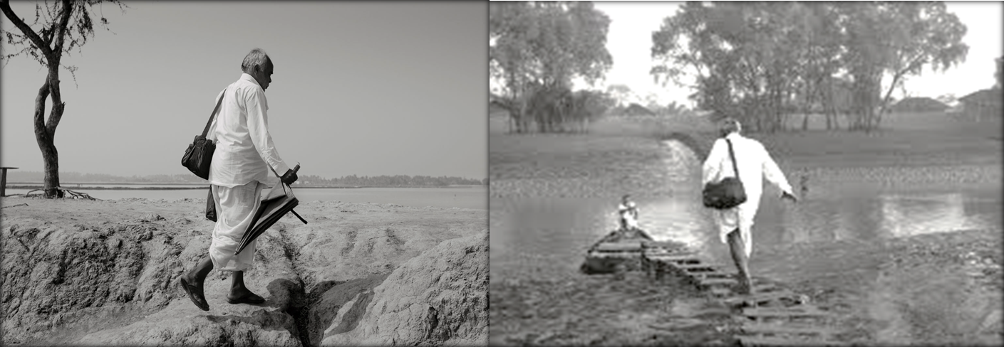
Doctor

Slide 5
Let us know what our lesson is.
It is a paragraph
“A Village Doctor”
From English First Paper
Writing part

Slide 6
Learning outcomes
After we have studied this lesson we will be able to-
Listen information
Ask and answer question
Write a paragraph

Slide 7
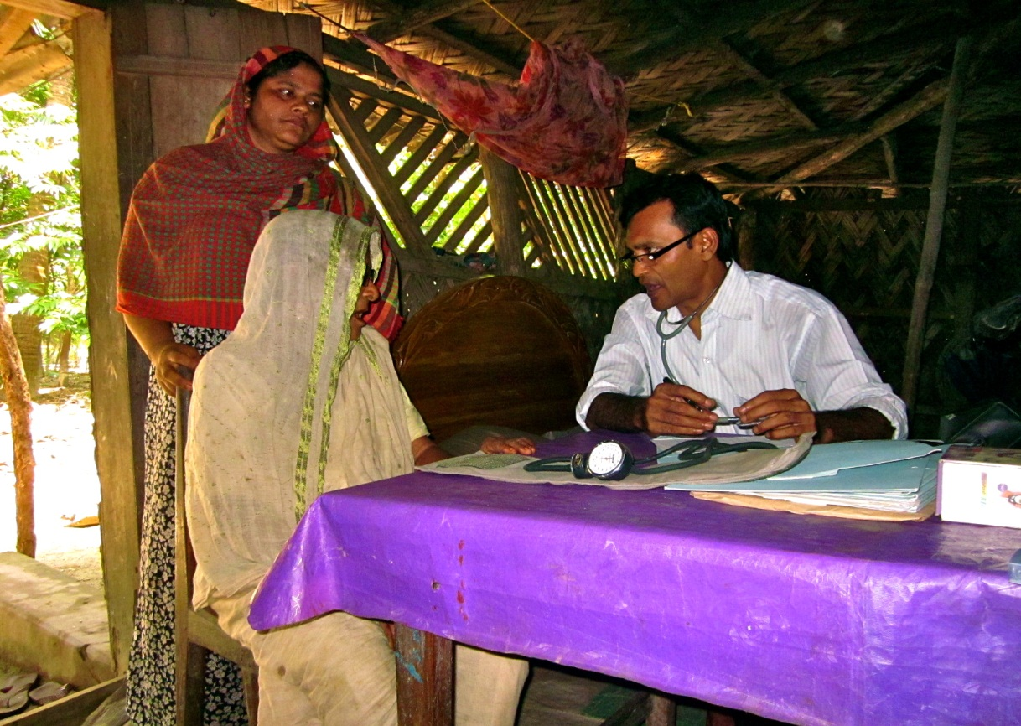
Who is a village doctor?
The doctor who serves in a village is a village doctor.

Slide 8
How is he known to the villagers?
He is well known to the villagers.

Slide 9
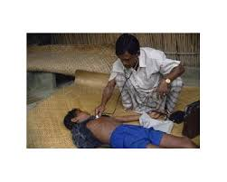
How do people like him?
People like him very much.
He also likes people very much.
But he?

Slide 10
How does he behave with the villagers?
He behaves very amicably with the villagers as his near and dear ones.

Slide 11
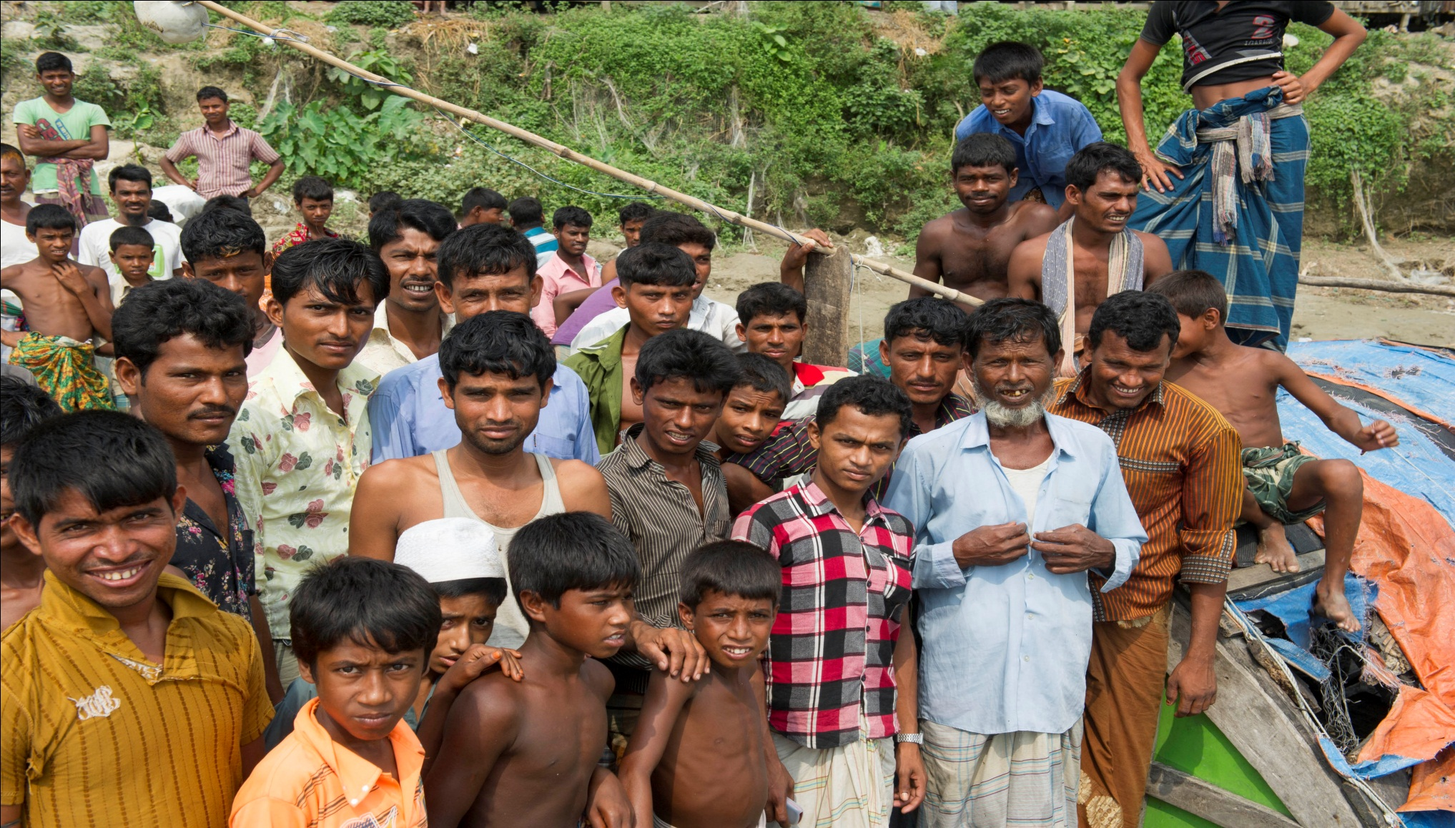
The village people also think him as their company of well and woe.

Slide 12
What is his main duty?
His main duty is to treat the village patients.

Slide 13
When does he treat the patients?
He treats the patients whenever he is called. He has no schedule time.

Slide 14
How does he demand for his treatment?
Actually he has no fixed demand. He is satisfied with what the people give him.

Slide 15
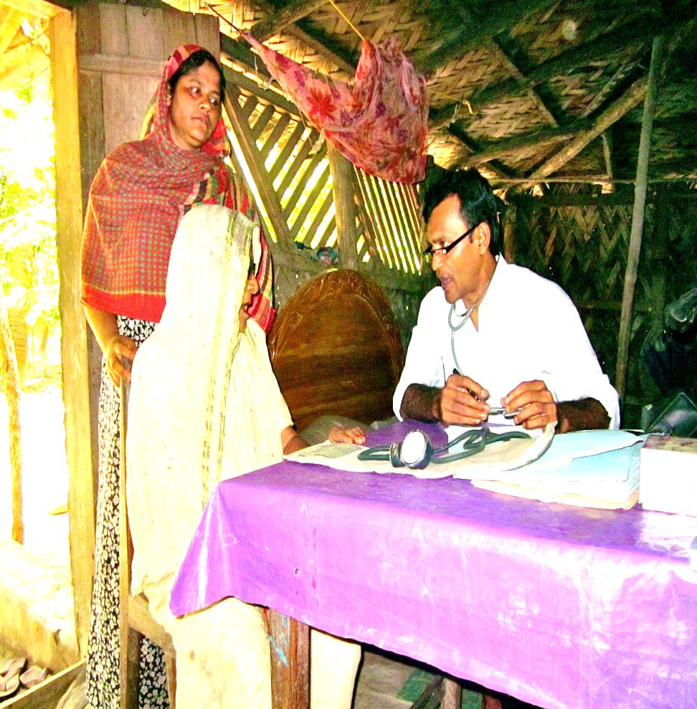
Where does he sit normally?
He has a personal chamber along with his residence. Normally he sits there.

Slide 16
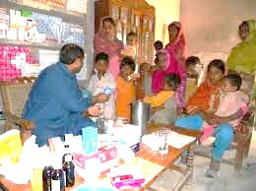
How does he provide medicine?
He has a dispensary of his own. He sells normal medicines from his dispensary. Specially medicine for fever and dysentery are always available in his dispensary.

Slide 17
What is the condition of his chamber?
The condition of his chamber is not well. There is a table in front of him and a wooden chair where he sits, there is also a chair for the patients to sit on. There are two or three low benches where his patients wait for their terms. Very often his chamber remains dirty and unhealthy. Sometimes patients are found groaning. They are seen very restless to have their term earlier than others.

Slide 18
What is the qualification of a village doctor?
What is his limitation?
Normally a village doctor is not well qualified. Very often he is seen as LMF qualified.
When he fails to treat a serious patient, he refers him to the nearby hospitals.

Slide 19
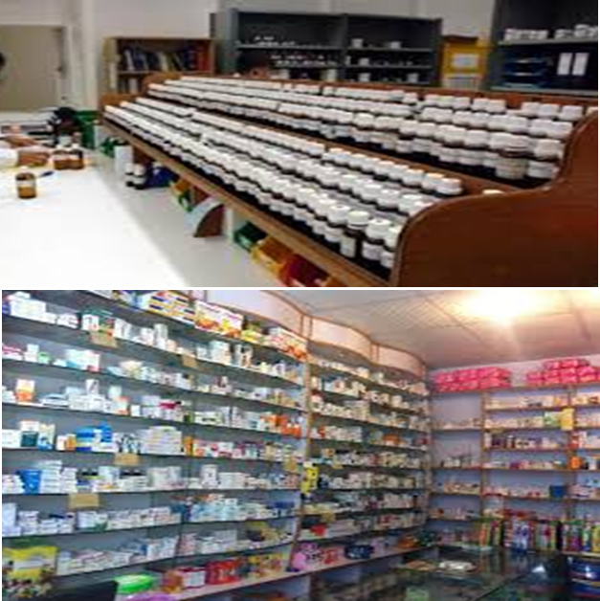
What kinds of treatments does a village doctor provide?
There are two kinds of village doctors. One is allopathic and another is homeopathic. Sometimes both kind of treatments are given by the same doctor.

Slide 20
Group Work

Slide 21
Make a logical assemble with the words, doctors, medicine, treatment, fixed, likes, treatment, initial, hospitals, chamber and any other words needed dividing 5 groups each having 6 students

Slide 22
Evaluation
Answer the following questions-
Who is a village doctor?
How does he serve village people?
How is his chamber?
When does he treat his patients?
How do the villagers like him?

Slide 23
Home Work
Write a paragraph on
“A Village Doctor.”

Slide 24
Verse
Prevention is better than cure.

Slide 25
Assalamu Alaikum

